Slide 1

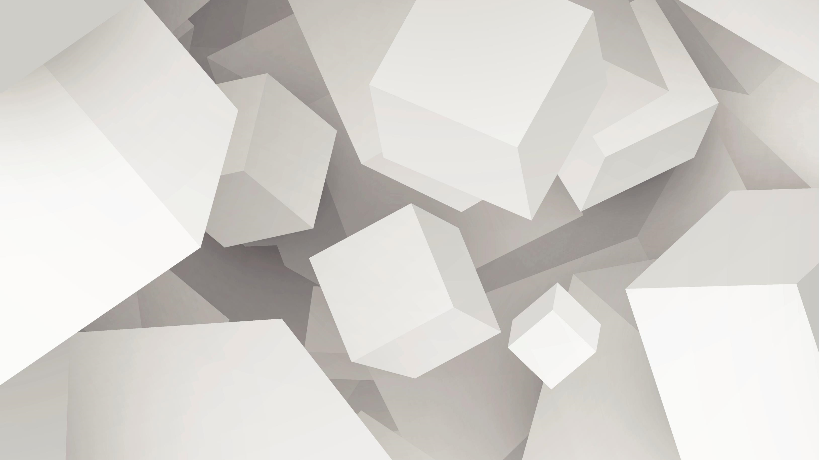
Rendering Fundamentals
Norwich University of the ARTS
Presentation by Ritchie Brannan

Slide 2
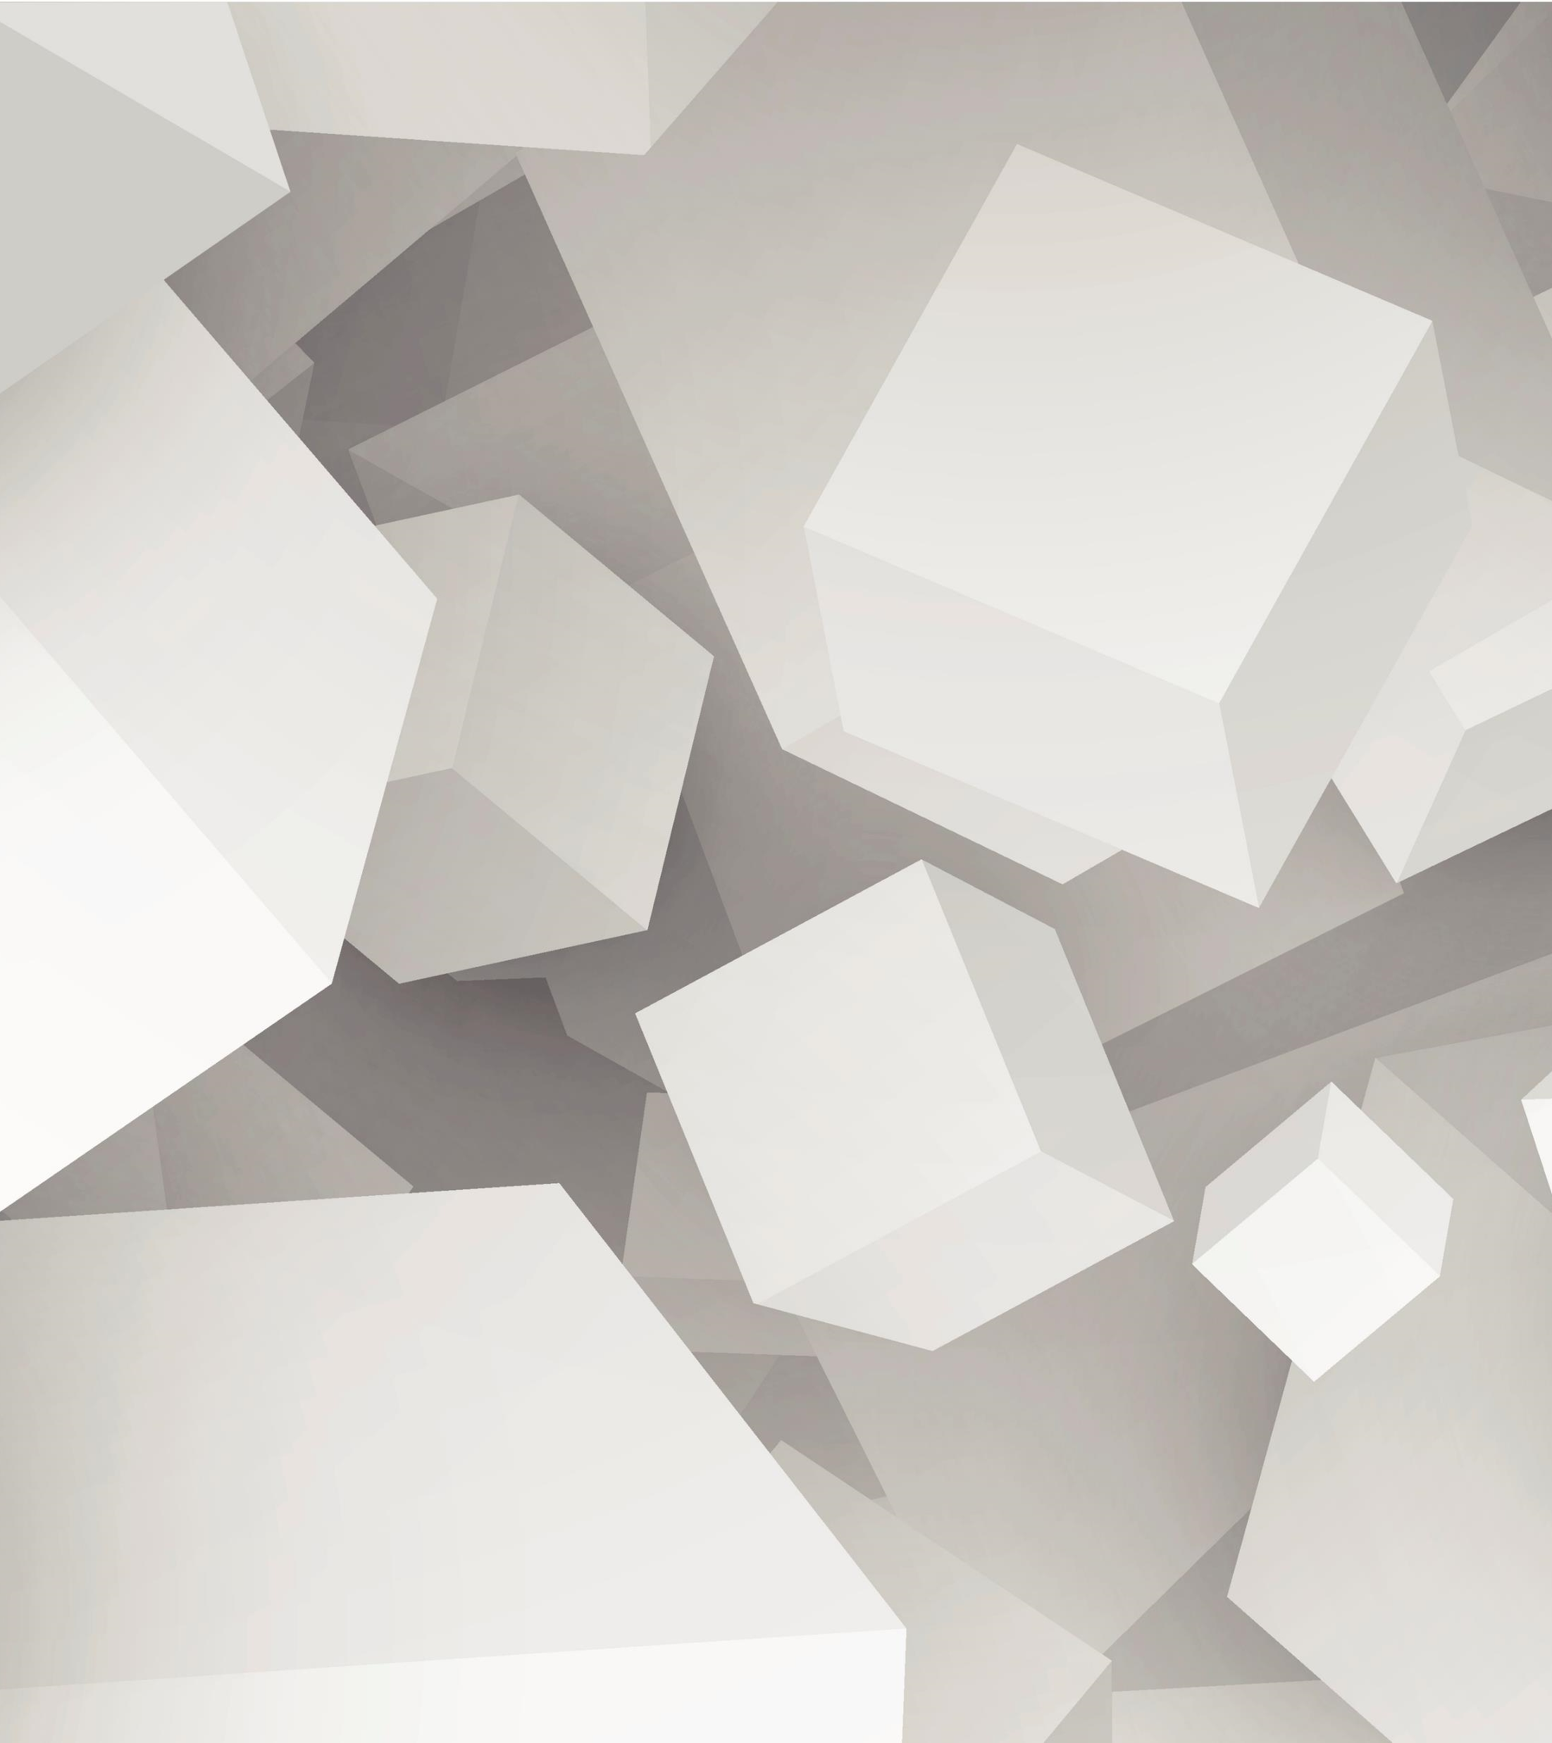

Abstraction

Slide 3
“Elephants all the way down”
UE4 materials are an abstraction of a subset of Shader functionality.
Shaders are an abstract representation of a model of GPU hardware.
GPU device drivers convert shaders to a further hardware abstraction consisting of a combination of fixed (but configurable) functions and programmable hardware.
Even the layer that device drivers convert to is usually a micro-code abstraction of the actual hardware.
“Programming to the metal” no longer really exists.

Slide 4
Coordinate representation in shaders and materials
Vectors
Vector4
Naming aliases

Slide 5
Shader vector basics
Vector: an array of components which can be thought of as coordinates.
Vector4: a vector with 4 components which is the primary register type (unit of operation) exposed to HLSL/GL shaders.
The components are labelled X, Y, Z, W and aliased to R, G, B, A
IOW: X is the same as R, Y is the same as G and so on.

Slide 6
Example swizzles and masks
The components can be accessed individually, in groups and out of order:
Z accesses the 3rd component of a vector, B accesses the same component
ZW is a vector2 and is equivalent to BA
XYZ is a vector3 and is equivalent to RGB
XYW is a vector3 and is equivalent to RGA
YZZX is a vector4 that ‘swizzles’ 3 components of another vector
And so on …

Slide 7
Naming conventions and Interpretation
XYZW
RGBA
UV(W)
ST
Other colour spaces (YUV, YCgCr…)

Slide 8
Texture and Mesh space conventions
Texture space axes:
2D textures have axes U and V (which map to X and Y)
3D textures have axes U, V and W (which map to X, Y and Z)
Confusingly, the W in UVW is not the same as the W in XYZW
Mesh space axes:
Meshes have axes S and T (which map to X and Y)

Slide 9
Colour space conventions
Colours are typically RGB.
With transparency this extends to RGBA, where A stands for Alpha.
You may also encounter other colour formats including:
HSV, HSL, YUV, YCgCr
These should generally be accessed using the XYZW component aliases
This avoids confusing the component axes and the colour space name
The specific mapping depends on the specific format

Slide 10
3D space conventions
Positions and directions are usually denoted as the XYZ vector3.
You may also encounter the XYZW homogenous vector:
A vector3 representing a position is usually promoted to XYZW with a W value of 1
This allows points to be translated when multiplied by an affine matrix
The point will be rotated, scaled and translated (moved) by the transform
A vector3 representing a direction is usually promoted to XYZW with a W value of 0
This makes sure that vectors are not translated when multiplied by an affine matrix
The direction will be rotated and scaled, but not translated (moved) by the transform
You may also encounter homogenous vectors as the result of transformation by a projection matrix
To convert this to a vector3 divide XYZ by W
This division is also done automatically as part of the rasterization and interpolation of Vertex shader outputs

Slide 11
2D coordinate spaces
Texture space
Screen space
Surface space
Post-projection space

Slide 12
2D spaces
General rules of thumb:
Texture space
Screen space
Mesh space
Post-projection space
U
U
S
{0, 0}
{1, 0}
{0, 0}
{1, 0}
{0, 0}
{1, 0}
{-1,1}
{1,1}
V
V
T
Y
{0, 1}
{1, 1}
{0, 1}
{1, 1}
{0, 1}
{1, 1}
{-1,-1}
{1,-1}
V may be inverted
X

Slide 13
3D coordinate spaces
Local/model space
World space
Camera space
Tangent space
Cube map space
3D texture space

Slide 14
3D spaces
Local/model space:
The space the model was constructed in.
World space:
The ‘world’ space an instance of the model has been transformed into.
‘Skinning’ will have been applied.
Camera space:
World space as seen from the camera’s location and orientation.
Tangent space:
A 3D space relative to a surface.
The X and Y axes are the surface tangents.
The Z axis is the surface normal.
Cube map space:
Orientation relative to a Cube map texture.
3D texture space:
Position relative to a 3D texture.

Slide 15
4D coordinate spaces
Homogenous space
Affine space
Clip space
Planes
Quaternions
…

Slide 16
4D spaces
You will come across 4D vectors and spaces.
Do not let them scare you!!!
The most common 4D spaces you will encounter are planes and homogenous vectors used to distinguish between positions and directions.
You will also encounter quaternions:
It is best to think of these as a compact representation of a 3x3 rotation matrix.
They are often more fool-proof than matrix equivalents.

Slide 17
Textures
2D textures
3D textures
Cube map textures
Texture arrays
Mip-Maps
Other resource types

Slide 18
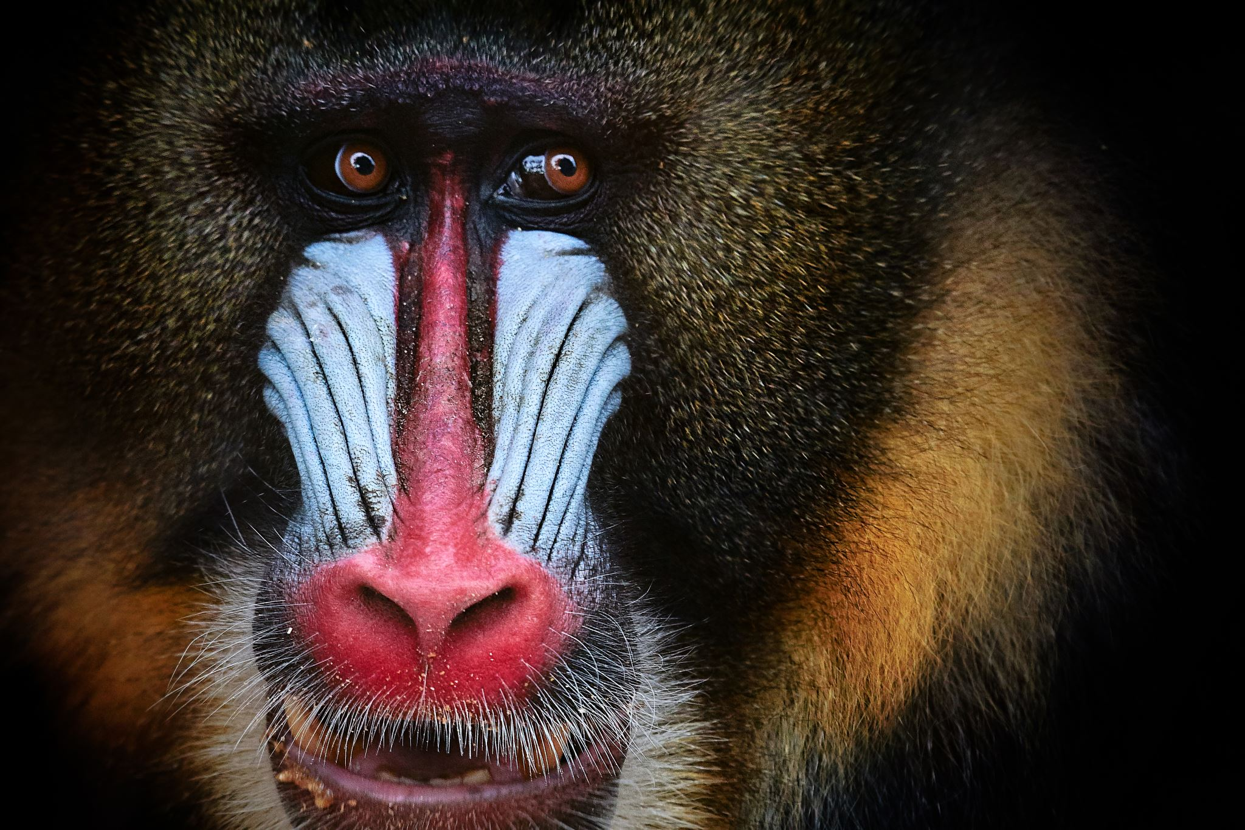
2D Texture with Mip-Maps
Each mip-map is half the width and height of the previous image:

Slide 19

3D Texture with Mip-Maps
A 3D texture consists of multiple 2D texture ‘planes’:

Slide 20

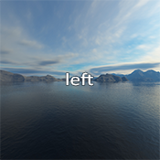
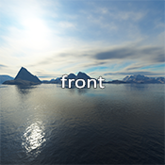
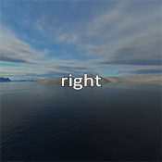
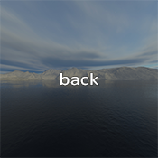

Cube-Map Texture with Mip-Maps
Faces must be square:
Top
Left
Front
Right
Back
Bottom
*Cube-maps are accessed using a UVW direction vector rather than a position

Slide 21
Array textures
An array texture is exactly what it sounds line – an array of textures.
The textures in the array must all be of the same fundamental type:
2D Textures or 3D Textures or Cube Maps.
The top level textures (i.e. ignoring mip-maps) must all be the same size.
The textures must all have the same pixel format type.

Slide 22
Other Resource types
Textures are a specialisation of the lower level Buffer Resource type.
Buffers can also exist as raw data buffers or have other specialised uses.
Commonly used Buffer Resources include:
Shader Constant Buffers:
These contain an array of constants that are used to configure shader behaviour.
These often include transform and projection matrices for the vertex shader, descriptions of lights for use in pixel shaders and other constants like colours.
Vertex Buffers
Index Buffers
More advanced buffer access can be achieved using Unordered Access Views (UAVs):
These enable access patterns including Linked Lists, FIFO, LIFO and improved random access.
Uses include: Order Independent Transparency (OIT), Tiled Lighting Lists, Ray-Tracing and more…

Slide 23
Samplers - Part 1
Texture caching
Texture filtering
Texture wrap/clamp/bound
Format conversion

Slide 24
Sampler basics (i)
Typically only 16 Samplers are available for use.
Samplers handle texture filtering and blending including mip-maps:
Point sampling will return the closest texel to the sampling point.
Bilinear blends between the closest texels.
There are multiple other filtering types…
Samplers specify what should happen when the UV coordinate is outside the 0:1 range:
Wrapping causes the sampler to treat the texture as tiled/repeated.
Clamping causes the sampler to clamp the UV to the 0:1 range.
Constant causes the sampler to return a fixed value if the coordinate is out of range.

Slide 25
Sampler basics (ii)
Samplers can also perform some basic format conversions:
RGB to SRGB and SRGB to RGB
Reads and writes to some compressed colour formats
Reads and writes to some compressed memory optimised buffer formats
Samplers interact with the Texture Cache to minimise latency and bandwidth.

Slide 26
Samplers - Part 2
Anisotropy
Derivatives
Perspective correction
Sub-sampling
Non-sampler indexed access

Slide 27
Samplers – Advanced (i)
Samplers interact with the Rasterizer to determine parameters required for filtering.
The main parameters supplied by the Rasterizer are pixel to pixel derivatives:
These are the rates of change in parameters such as UV coordinates.
Derivatives help describe the relationship between texel size and screen pixel size.
This influences mip-map choice and filtering to optimise both appearance and performance.
Derivatives used by the Sampler can be manually over-ridden in shader code.
Problems can occur with Shader UV manipulation:
Non-linear UV discontinuities can result in large or discontinuous derivatives.
This can result in filtering causing tearing of the texture.

Slide 28
Samplers – Advanced (ii)
Perspective correct texturing:
This accounts for the conversion of linear 3D interpolation to 2D rasterization.
The conversion means that the 2D interpolation is non-linear (curved).
Most perspective correction processing is done by the Rasterizer and Interpolators:
Samplers may also account for perspective correction in their filtering.
Perspective correction parameters are supplied by the Rasterizer and Interpolators.
Anisotropy controls how much the sampler accounts for perspective correction.
Higher Anisotropy settings produce better images, but the processing, memory bandwidth and texture cache cost increase exponentially.

Slide 29
Samplers – Advanced (iii)
Sub-sampling:
The Rasterizer often operates at an image resolution that is higher than the buffer resolution.
Conversely, Pixel/Fragment shaders often operate at an image resolution that is lower than the buffer resolution.
Sub-sampling is the process of Shaders modifying sampler inputs to sample textures at the higher resolution of the Buffer and/or Rasterizer.
Centroid sampling:
This is another example of sampling at a location other than supplied to the shader.
This repositioning can account for geometry that only partially covers a pixel

Slide 30
Non-sampler indexed access
Samplers are not the only way to access Resource Buffers (including Textures)
Resources can be accessed by Direct Indexing:
For some resource types Direct Indexing is the only access method.
Examples include: Constant Buffers and UAVs.
Direct Indexing uses integer indices:
e.g. For a texture of width 16, an index of 15 will access the right-most ‘texel’.
Choosing between Direct Indexing and Sampling must be done on a case by case basis:
Direct Indexing gives raw access with no sampler settings or processing applied.
Sampler access includes some extra processing and can optimise bandwidth usage.
For some types of Resource the only choice is Direct Indexing.

Slide 31
The GPU pipeline
Shaders
Fixed function hardware

Slide 32
API Hardware Abstraction View
Vertex assembly
Vertex shader
[ | ]
Hull shader
Tessellator
Domain shader
* Optional geometry amplification stage(s)
* Fixed function stage
Geometry shader
{Rasterizer}
Pixel/Fragment shader
* Fixed function stage
* Optional with some hardware configurations
Compute shader

Slide 33
UE4 Materials and the GPU Pipeline
Base Color, Metallic, Specular, Roughness and Emissive Color:
Modifies the Pixel shader (code and inputs) .
Opacity, Opacity Mask and Pixel Depth Offset:
Modifies the Pixel shader (code and inputs) and the Rasterizer state.
Anisotropy:
Modifies the Pixel shader (code and inputs) and Sampler states.
Normal and Tangent:
Modifies the Pixel and Vertex shader (code and inputs) and may modify the vertex assembly.
World Position Offset:
Modifies the Vertex shader (code and inputs).
World Displacement and Tessellation Multiplier:
Modifies the geometry amplification shader stages and the Tessellator state.

Slide 34
GPU Hardware
Most actual hardware does not appear as it is presented by SDK APIs.
Device drivers convert between the configuration supplied by the SDK and the actual hardware available. This often includes re-compilation of the compiled shaders and sometimes multiple passes for what appears to be a single pass through the pipeline.
Often broken down into hardware specific shader types and processing blocks that can be re-purposed depending on the total configuration of the pipeline specified by the SDK.
When working with consoles, you may be exposed to some of the actual hardware and see shader types with names such as: Input, Import, Export, Local, Memory …
Operations are massively parallel and asynchronous.

Slide 35
DirectX 12 and Vulkan
DirectX 12 and Vulkan combine all the shader types and GPU state into a single Pipeline State Object for each configuration (combination of shaders and state) that will be used for a draw-call.
By doing this, they allow the driver to validate that configuration, translate it into hardware specific shaders, configuration and state and perform any required recompilation and micro-code generation.
This is an optimisation that improves both CPU and GPU efficiency, by eliminating repeated validation and re-compilation that is performed for every draw-call with earlier SDKs.

Slide 36
The Rasterizer - Part 1
Basic operation (ROPS)
Depth
Stenciling
Blending

Slide 37
Rasterizer basics (i)
At its most basic, the Rasterizer converts geometry from pure linear floating point vertices and edges into rows of quantized pixel positions in a Render Target Buffer.
Rasterizer operations (ROPS):
Depth and Stencil testing and writing.
Back-face culling.
Clipping to the Buffer.
Blending Pixel/Fragment shader output with the Buffer.

Slide 38
Rasterizer basics (ii)
The Rasterizer can render to the Depth/Stencil without a Pixel/Fragment shader:
This can often be done at a much higher speed than when a Pixel shader is active.
Pre-pass depth operations take advantage of this to accelerate the main rendering.
Other Rasterizer processing:
Controls Pixel shader invocation for pixels that need shading.
Suppling rasterization generated parameters to the shader.
Distribution of shader output to 1 or more buffer texels in 1 or more buffers.
Memory bandwidth optimization and compression.

Slide 39
The Rasterizer – Part 2
Centroid calculation
Derivatives calculation
Perspective correction
Memory access optimization
Multi-Sample Anti-Aliasing
Variable Rate Shading

Slide 40
The Rasterizer – Advanced (i)
The rasterizer works closely with the interpolators supplying data to the pixel/fragment shader.
The line between the rasterizer and the interpolators is fuzzy in hardware:
On some hardware interpolation is part of the rasterizer functionality.
On some it is distinct separate hardware.
On others interpolation is actually a sub-part of the pixel/fragment shader.
In all cases the rasterizer calculates the required parameters to perform interpolation.

Slide 41
The Rasterizer – Advanced (ii)
The rasterizer calculates derivatives for use by the shaders:
This is often done by rasterizing at multiples of the resolution of the buffer.
The rasterizer also:
Calculates perspective correction parameters.
Determines appropriate relative coordinates at which shaders will be invoked.
Applies Centroid clamping of the relative invocation coordinates.
…

Slide 42
The Rasterizer – Advanced (iii)
Some rendering settings can change the order of parts of the rasterization:
Notably, shaders which modify depth output causes some optimisations to be disabled.
In this case the rasterizer may not know the depth to test or to write.
This can cause significantly increased processing costs.
Some hardware/drivers attempt to minimise this cost by separating out all shader paths that influence the depth or stencil from all other shader processing. In these cases the depth/stencil part of the shader is executed before the rasterizer depth testing and the remainder only executed if the test has passed.

Slide 43
The Rasterizer – Advanced (iv)
Multi-Sample Anti-Aliasing (MSAA):
The rasterizer renders to depth at a higher resolution than the buffer.
This rasterization uses ‘hidden’ extra accumulation buffers in the GPU memory.
The shaders operate at the buffer resolution and their output is sent to all the sub-fragments generated by the rasterizer.
The rasterizer averages (down-samples) the fragments overlapping a pixel before writing them to the buffer.
This gives the appearance of smooth anti-aliased edges without the cost of fully rendering at a higher resolution and then down-sampling.

Slide 44
The Rasterizer – Advanced (v)
Variable Rate Shading (VRS):
This is a variation on MSAA.
Allows the ratio of shader invocation to rasterizer resolution to be specified:
Per-draw-call.
Per-primitive
By position within the buffer.
Allows shaders to be invoked less frequently that MSAA usually allows.
This gives finer control over performance and rendered image quality.

Slide 45
The Rasterizer – Advanced (vi)
Some GPUs (predominantly mobile GPUs) implement tile based rasterization:
This breaks the Render Target into smaller sub-blocks.
Each block is rasterized separately.
Often, these rasterizers will use span buffers rather than depth buffers.
Span buffers:
An alternative to depth buffers for hidden surface removal.
Geometry is broken down into single pixel horizontal strips.
Each strip is then tested to see if and where it overlaps other strips in the buffer.
The resulting clipped row of strips is then output to the buffer in a single pass.

Slide 46
Rendering pipelines
Forward rendering
Forward+ rendering
Deferred rendering
Ray-Tracing
Compute
Hybrids

Slide 47
Forward, Forward+ and Deferred
Non-exhaustive passes flow:
Pre-passes
The ‘base’ pass
Lighting pass
Transparency
Post-Processing
Forward rendering and lighting pass
N/A
Depth (and stencil) pre-pass
or
Tiled lighting pre-pass
Forward rendering and tiled lighting pass
[Forward+ rendering]
Transparency passes
Post-Processing passes
N/A
Shadow map generation passes
or
G-Buffer pass
Lighting or tiled lighting pass

Slide 48
Post processing
Post-processing can be applied to any rendering type.
Example post-processing passes:
Colour space conversion
HDR to LDR conversion
Gamma correction/curves
Tone-mapping
Film grading
Ray-Tracing De-Noise
Bloom
Bokeh
Special effects
…

Slide 49
Ray-Tracing
High level view:
Upload
Traversal optimisation
Ray-Tracing
De-Noise
Cast rays through the model in memory.
Geometry
Textures
Material descriptions
Surface properties
Additional traversal code
Ray-Tracing sub-system generates traversal optimisation structures and data base.
Depending on the technique, the rays may be cast from the camera or the lights
Removes ‘noise’ and ‘speckles’ from the ray-traced image,
Construct: bounding regions, oct-trees, distance fields and other relationship mappings
The tracing is recursive with a number of bounces specifying the number of surfaces that can be hit before terminating.

Slide 50
Compute and Hybrid
Compute based rendering uses a GPU Compute shader ‘software’ renderer.
Hybrid rendering models mix multiple approaches to rendering.
UE5 is a primarily compute based hybrid model that includes aspects of all the rendering pipelines outlined in this presentation.
UE5 also implements a Direct Memory Access (DMA) scheme to stream resources directly from an NVME PCIE4 SSD to the GPU without going through CPU memory.

